Slide 1

Enhancing Safety-Critical Systems: RTOS Hardening Techniques
As safety and mission-critical systems evolve, they require increasingly complex designs to meet modern demands. This presentation explores the challenges of securing these systems, particularly focusing on Real-Time Operating Systems (RTOS) in environments susceptible to radiation-induced faults. We'll examine the importance of RTOS hardening, fault injection analysis, and targeted solutions to improve system reliability without compromising performance.
By Usman Asif | Ahmed Fraz | Abdullah Atif
Notes:
1

Slide 2


The Evolution of Safety-Critical Systems
1
Past: Bare-Metal Systems
Previously, safety-critical systems relied on simple, single-core CPUs dedicated to specific tasks.
2
Present: Complex Hardware
Modern systems now utilize multicore CPUs, GPUs, and other accelerators, requiring sophisticated software management.
3
Future: OS-Controlled Systems
The introduction of operating systems to manage complexity introduces new challenges in ensuring system dependability.
Notes:
2

Slide 3
Understanding Radiation Effects
Radiation Exposure
Single-Event Upsets (SEU)
Failure Types
Both space-based and ground-level systems are susceptible to space radiation, which can cause faults in hardware components.
Radiation can cause bit flips in memory elements, leading to single-event errors that may propagate through system layers.
Errors can result in Silent Data Corruption (SDC) where incorrect outputs are produced, or Functional Interruption (FI) causing system halts or erratic behavior.
Notes:
3

Slide 4




Fault Propagation Model
Hardware Fault
A fault occurs in hardware components such as registers, caches, or RAM.
Error Propagation
The fault may propagate to software, resulting in errors if not masked by hardware.
System Failure
Errors that reach the application level can lead to system failures, impacting overall behavior.
Notes:
4

Slide 5
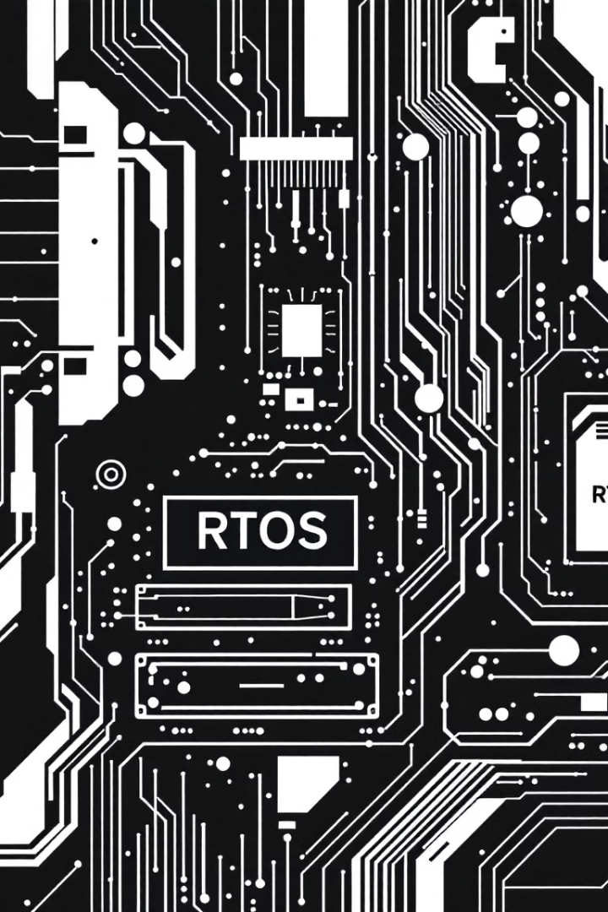
The Need for RTOS Hardening
1
Hardware Limitations
2
COTS Adoption
While hardware-level hardening techniques are effective, they are often prohibitively expensive for widespread implementation.
Industries are increasingly turning to commercial off-the-shelf (COTS) devices due to their lower cost and high performance.
3
Software Solutions
To compensate for the lack of built-in hardening in COTS devices, fault tolerance techniques must be implemented at the software level, particularly in the operating system.
Notes:
5

Slide 6

Fault Injection Techniques
Parameter
Description
System Definition
Testing on simulation or hardware prototype
Fault Models
Bit flips, radiation effects, etc.
Injection Mechanism
How faults are introduced (simulated/physical)
Observability
Visibility into system's fault response
Fault Injection (FI) is a crucial technique for testing system resilience by deliberately introducing faults. Previous research has focused on various FI methods but often lacks comprehensive coverage of all OS components or sufficient experimental results.
Notes:
6

Slide 7




RTOS Experiments: FreeRTOS
Target System
FreeRTOS, a lightweight RTOS commonly used in embedded systems
Fault Injection Areas
Global kernel variables, Task Control Block structures, synchronization mechanisms
Observed Behaviors
Crashes, freezes, degradation, and silent misbehavior
Notes:
7

Slide 8

Experimental Results
Vulnerable Components
Test Environment
Fault injection carried out on STM32F3DISCOVERY boards running FreeRTOS
Certain variables, such as pointers in task lists, showed particular vulnerability to faults
Common Misbehaviors
Impact Assessment
Crashes and freezes were frequently observed in specific scenarios
Results highlighted the need for targeted hardening of critical RTOS components
Notes:
8

Slide 9
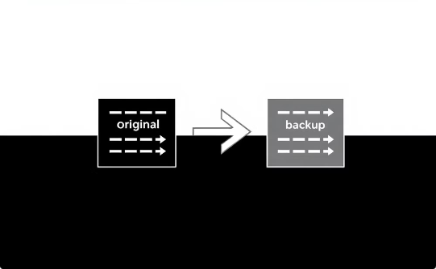


Hardening Recommendations
Data Redundancy
Error Detection
Performance Trade-offs
Add redundancy for critical variables, such as tripling data and using majority voting to ensure accuracy.
Implement robust error detection and correction mechanisms to catch and resolve faults before they propagate.
Consider the balance between improved reliability and potential computational overhead, especially in real-time systems.
Notes:
9

Slide 10


Conclusion and Future Work
1
RTOS Importance
2
Selective Hardening
The study demonstrates the critical role of RTOS in safety-critical systems and highlights specific vulnerabilities in FreeRTOS.
Proposed techniques focus on targeted fault tolerance to enhance reliability without excessive performance costs.
3
Future Research
Continued work is needed to refine hardening techniques and explore their application in diverse safety-critical environments.
Notes:
10

